Slide 1
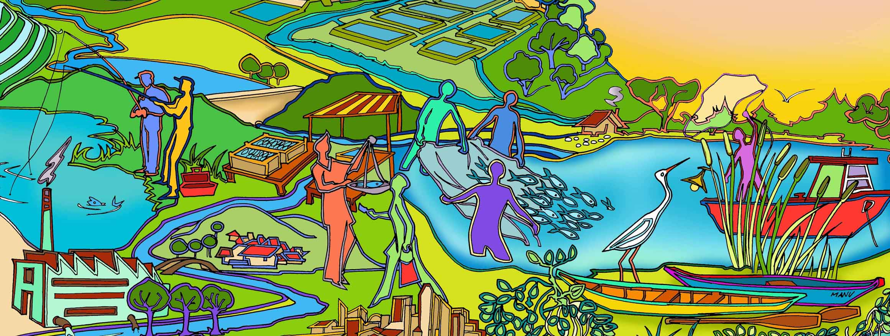
Session 4 (Activity) How much EAFm are you already doing?
Essential EAFm training
Date |Place

Slide 2
Session objectives
After this session you will be able to:
Revisit your threats and issues and cluster them according to the three EAFm components
Realize that you are already doing some aspects of an EAFm
Analyze your current fisheries practices and identify what EAFm you are already doing
Identify gaps in your EAFm practices and possible ways to move forward
Notes:
Self explanatory.

Slide 3
Activity 1
Revisit threats and issues from this morning. Do any more need to be added?
Now working as a group - start to group the threats & issues into the three EAFm components:
Ecological well-being
Good governance
Human well-being
Notes:
As participants come back from afternoon break, ask them to revisit all threats and issues brainstormed onto wall in the morning. Use three column in flipchart.
Activity 2. in mixed/table groups. Ensure participants walk around and see each other’s work. They must also keep notes of their clustering. HOW: participants write down the issues from the wall on blank cards and group the cards on their flipchart paper on their tables. Can have 2 sheets stuck together to create more space. Must have 3 components as headings on paper.
Some threats/issues will span 2 or all 3 components. Decide which is most relevant (you can draw dotted lines to show connections between components/issues).
Trainer: Ensure all group outputs are correctly labelled and stored safely as they will be used on day 2.

Slide 4
Activity 2: Analyze your current fisheries management approaches and practices
Individually: think which, if any, of the 7 EAFm principles are already being applied in your fishery, and to what extent?
Share these in your table groups. Keep notes.
Notes:
The aim is for participants to think individually for 5 minutes about what aspects of EAFm they may already be doing, and where the gaps are. Then share their ideas in table groups before trainer elicits one example from each table in plenary.

